Slide 1
Training Forum
31 May 2023

Slide 2
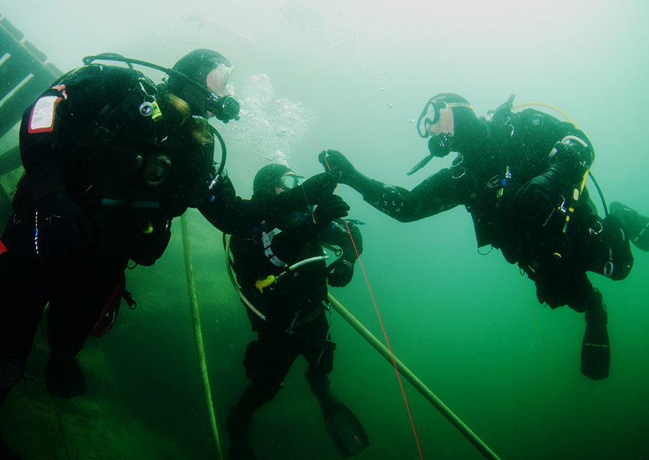
Update Topics
Sports Diver Updates
Dive Leader Updates
Deep Module
BSAC App
Sandford & Down Partnering & eLearning
Forward Trg Programme

Slide 3
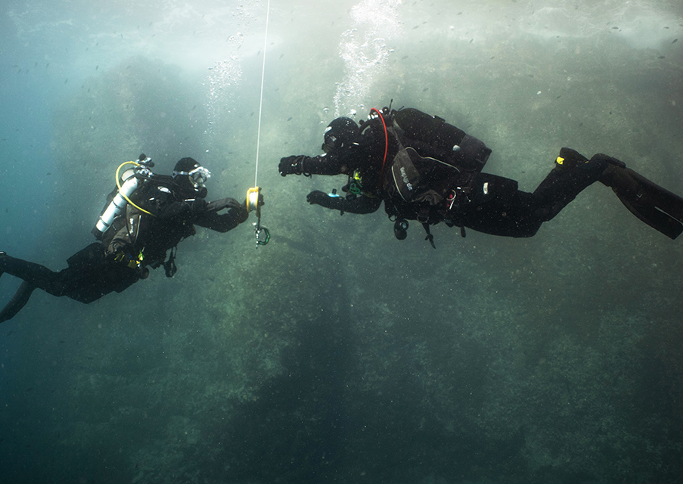
Sports Diver
With immediate effect:
AED included in Sports Diver Syllabus and updated BLS
Aligned to O2 Admin & Dive Leader
Sports Divers depth limit increased to 40m
Applies to ALL Sports Divers: qualified or in training
In 5m increments, under NQI supervision

Slide 4
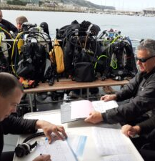
Dive Leader
For all Dive Leaders yet to start training (from mid-Jun onwards):
O2 Admin now precursor to the course, rather than included in it.
More focus on Dive Leading with trainees to consolidate skills
Max Depth Limit for new Dive Leaders now 40m
If already qualified as Dive Leader, or currently in training, max depth remains 50m
Why? Gas Density below 40m on air is hazardous

Slide 5
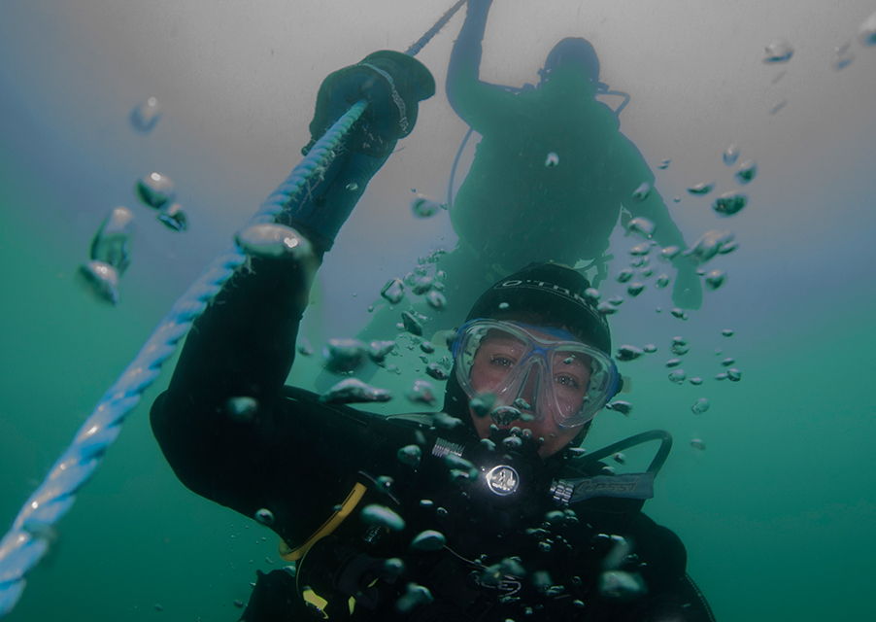
Deep Module
BSAC will be introducing a Deep Module for depth from 40m to 50m (from End Aug)
Gas Planning
Equipment Configuration
Choice of gas for depth progression – air, nitrox, trimix
Open to both Sports Divers and Dive Leaders

Slide 6
What does this mean for Sports Diver & Dive Leader Qualifications?
Previously:
Individual Skills
Individual Skills/Intro to Dive Management
Rescue Skills/Dive Management
Expedition Management Skills
Running BSAC etc
Ocean Diver
20m
Sports Diver
35m
Dive Leader
50m
Advanced Diver
50m
1st Class Diver
50m
Now:
Ocean Diver
20m
Sports Diver
40m
Dive Leader
40m
Advanced Diver
40m
1st Class Diver
40m
Deep Module
50m

Slide 7
BSAC App

Slide 8
Keeps all your information in one place

Slide 9
Instructors also get “Training” Function

Slide 10
Can Search for Student Under Training

Slide 11
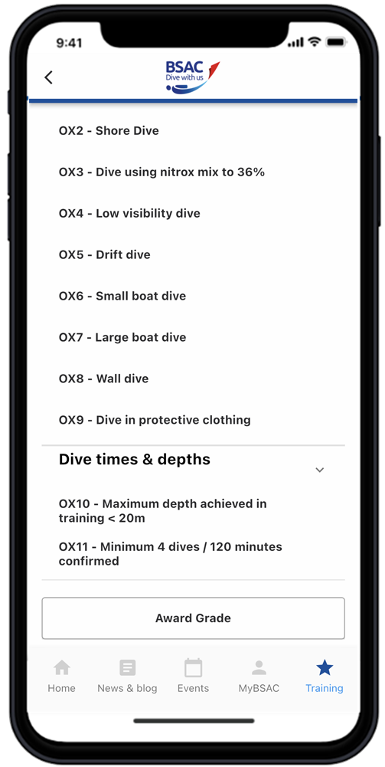
Can Sign Off Lectures, Dives & Qualification

Slide 12
Sandford & Down Partnering & Online Training
Working with Sandford & Down to deliver some Ocean Diver Training
Aim is to increase no of courses/year & satisfy requirements from CATIs
Reduce instructor workload
Students will join Totnes SAC, theory delivered online under S&D supervision, S&D deliver practical training using our pool and qualification dives in the sea: S&D will deliver qualified ODs back to us
Final details (including cost!) tbc so still a work in progress but hope to be ready to launch soon
BSAC now provide OD & SD Theory lessons as eLearning packages.
Allows students to “self teach” using guided learning: combination of both lectures and reading with confirmation questions.
Have trialled with current Ocean Diver Course with Richard Knights supervising
Generally very satisfied although an extra confirmation session or two required to check on progress
Now being used on current Sports Diver Course
Links directly to App so training is directly recorded there

Slide 13
Training Programme 2023

Slide 14
Questions? https://www.youtube.com/watch?v=ya7LGbwc3PE

